Slide 1

Constructing Boolean Algebras
Gayan Rukshantha gayanp@nsbm.lk
Lecturer
Faculty of Computing
NSBM Green University

Slide 2
The Truth Table
An automated cooling system consist with three sensors X, Y, Z. The system automatically turns ON (1/True) and OFF (0/False) when following conditions apply from the three sensors.
X | Y | Z | System
0 | 0 | 0 | 0
0 | 0 | 1 | 0
0 | 1 | 0 | 1
0 | 1 | 1 | 0
1 | 0 | 0 | 1
1 | 0 | 1 | 1
1 | 1 | 0 | 0
1 | 1 | 1 | 1

Slide 3
Mintems & Maxterms
Minterms –
Represents exactly one combination in the truth table.
Denoted by m_{j}, where j is the decimal equivalent of the minterm’s corresponding binary combination (b_{j}).
A variable in m_{j} is complemented if its value in b_{j} is 0, otherwise is uncomplemented
Maxterms –
Represents exactly one combination in the truth table.
Denoted by M_{j}, where j is the decimal equivalent of the maxterm’s corresponding binary combination (b_{j}).
A variable in M_{j} is complemented if its value in b_{j} is 1, otherwise is uncomplemented.

Slide 4
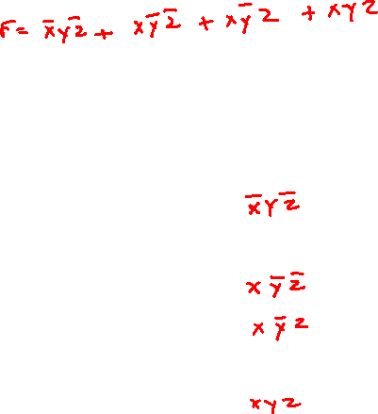
Mintems & Maxterms
X | Y | Z | System
0 | 0 | 0 | 0
0 | 0 | 1 | 0
0 | 1 | 0 | 1
0 | 1 | 1 | 0
1 | 0 | 0 | 1
1 | 0 | 1 | 1
1 | 1 | 0 | 0
1 | 1 | 1 | 1

Slide 5
In a simple copy machine, a stop signal, S, is to be generated to stop the machine operation and energize an indicator light whenever either of the following conditions exists:
(1) there is no paper in the paper feeder tray; or (2) the two microswitches in the paper path are activated, indicating a jam in the paper path. The presence of paper in the feeder tray is indicated by a HIGH at logic signal P. Each of the microswitches produces a logic signal (Q and R) that goes HIGH whenever paper is passing over the switch to activate it.
Design the logic circuit to produce a HIGH at output signal S for the stated conditions, and implement it using the 74HC00 CMOS quad two-input NAND chip.

Slide 6
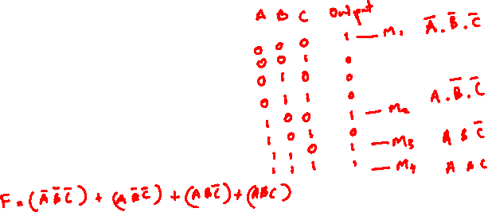
Standard Forms
There are two types of Standard Forms
Sum Of Products
Products of Sum

Slide 7
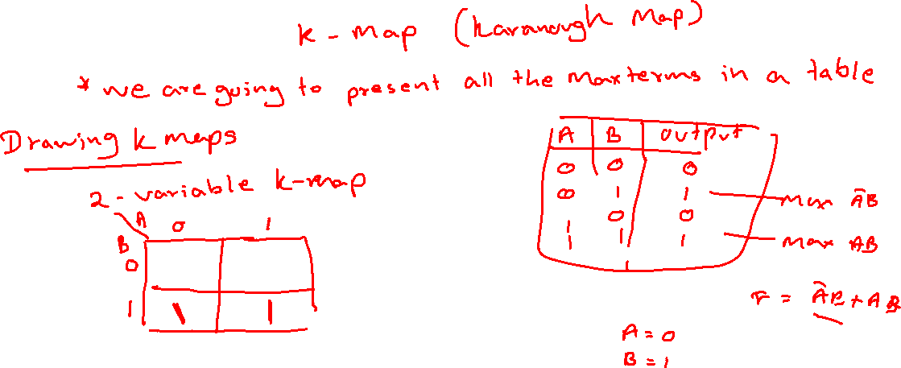
Sum of Products
Simplifying Boolean Expressions using Graphical Approach

Slide 8
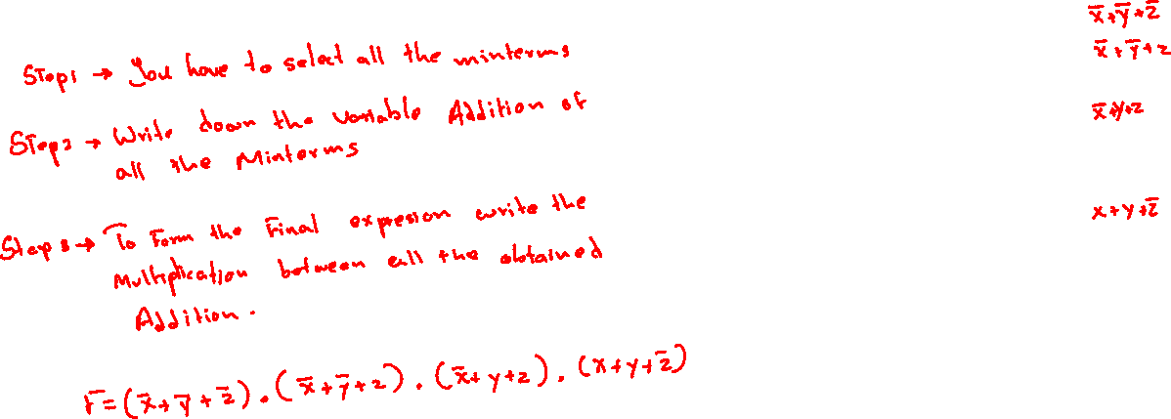
Product of Sum
X | Y | Z | System | Term
0 | 0 | 0 | 0 | Minterm
0 | 0 | 1 | 0 | Minterm
0 | 1 | 0 | 1 | Maxterm
0 | 1 | 1 | 0 | Minterm
1 | 0 | 0 | 1 | Maxterm
1 | 0 | 1 | 1 | Maxterm
1 | 1 | 0 | 0 | Minterm
1 | 1 | 1 | 1 | Maxterm

Slide 9
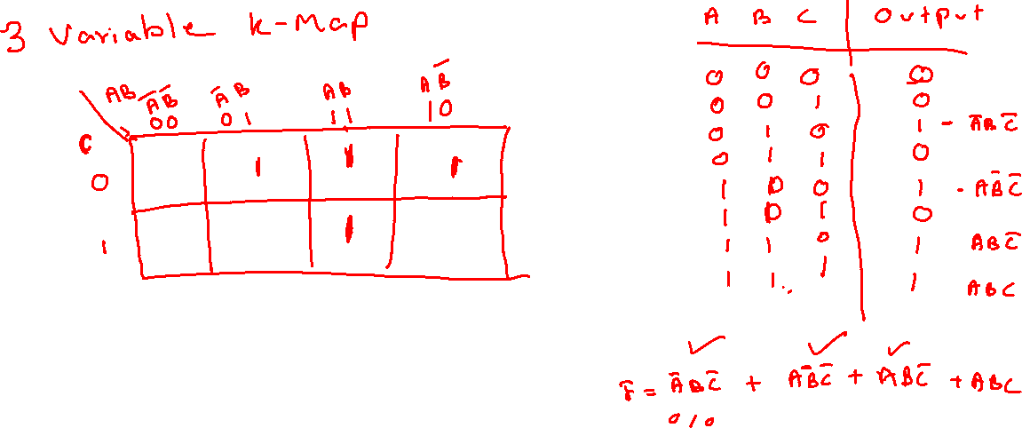

Slide 10
Products of Sum

Slide 11
Thank You !!

